Slide 1
Plant Disease Prediction System
Presented By:
Ameer Hamza (Fa19-BSCS-443)
Moeez Ammar (Fa19-BSCS-134)
Sidra Iftikhar (Fa19-BSCS-117)
Presented To: Miss Gulshan Saleem

Slide 2
Plant Diseases
Early detection and accurate diagnosis can prevent crop losses, reduce pesticide usage, and enhance agricultural productivity.
To provide an overview of plant disease prediction using Deep learning and highlight its significance in agriculture.

Slide 3
Important Libraries
Tensorflow
Keras
Numpy
Os

Slide 4
FrontEnd
Flask
HTML
CSS

Slide 5
Model Used
MobileNetV2
Custom VGG19
Used Transfer Learning to Train MobileNetV2 Model on VGG19 with the Process of Hybridization

Slide 6
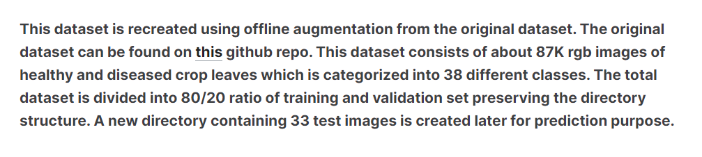
Dataset
https://www.kaggle.com/datasets/vipoooool/new-plant-diseases-dataset

Slide 7
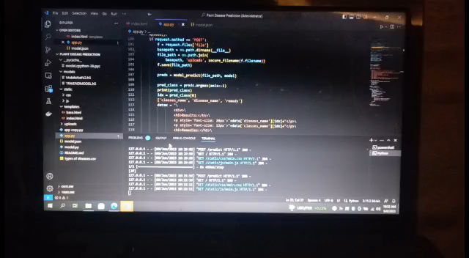
Model Demonstration

Slide 8
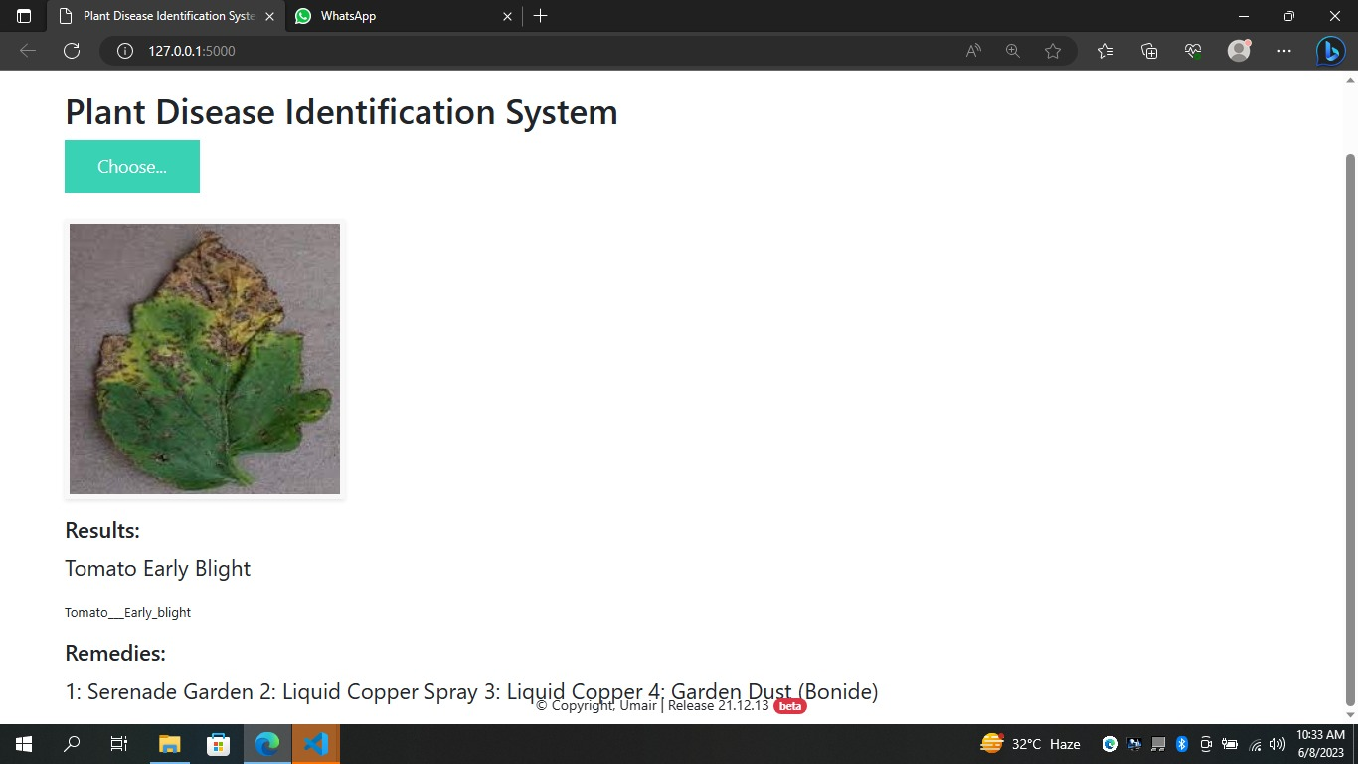
Result

Slide 9
THE END

